Slide 1
Incorporating Indigenous Perspectives into the Music Classroom
MU202, Fall 2018
Niki Kazemzadeh
kaze6850@mylaurier.ca

Slide 2
Acknowledgement
I would like to begin by acknowledging that the land on which we gather today is the land traditionally used by the Haudenosaunee, Anishinaabe and Neutral People. I also acknowledge the enduring presence and deep traditional knowledge, laws, and philosophies of the Indigenous People with whom we share this land today.

Slide 3
“I have a mother who comes from another land. She comes from Germany. If my mom’s relatives, my mom, she lost her language, she lost her cultural traditions, she lost all of those things, she could get on a plane, she could head back to Germany, she could learn all those things, and she could come back here and share all of that with her family and her friends and all the people that she knows. My Dad, he’s a Michif. His culture, his language, lives right here, was BORN here. And he lives here. So he can’t go to ‘Michif land’ to get that. Because that exists right here. So, if our cultures don’t live in the curriculum of the place where they were born, where else will they?” -Angie Caron from the podcast ‘Think Indigenous’

Slide 4
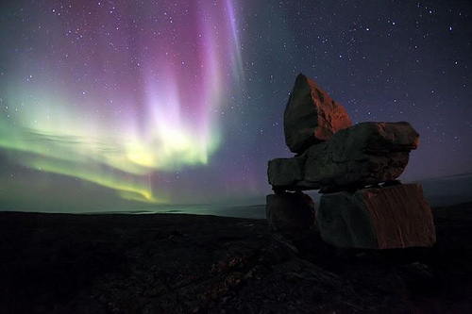
Who are the Inuit?
The Inuit are the aboriginal inhabitants of the North American Arctic, from Bering Strait to East Greenland, a distance of over 6000 kilometres. As well as Arctic Canada, Inuit also live in northern Alaska and Greenland, and have close relatives in Russia. They are united by a common cultural heritage and a common language. Until recently, outsiders called the Inuit "Eskimo." Now they prefer their own term, "Inuit," meaning simply "people." There are about 40,000 Inuit in Canada.

Slide 5
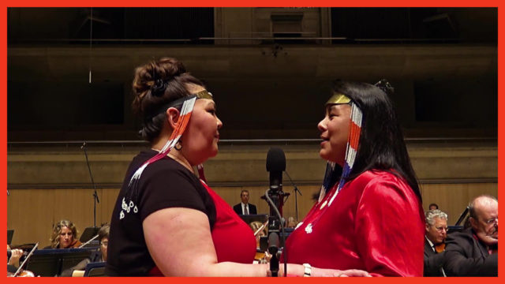
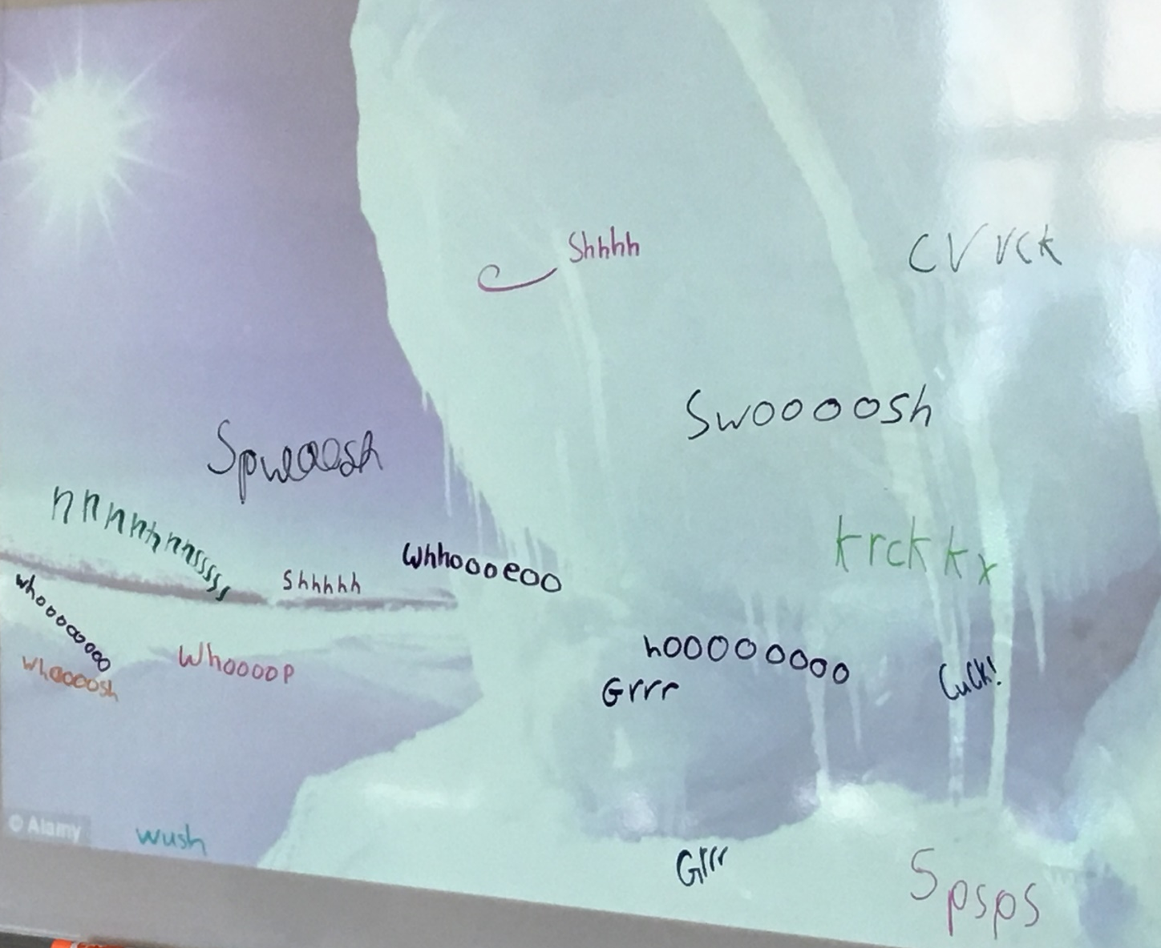
Arctic Soundscapes and a look at Inuit throat singing
Toronto Symphony Orchestra: Canada 150
Inuit Games piece and lessons:
http://bit.ly/2rbmEZ1

Slide 6
Tanya Tagaq: The Sounds of Throat Singing

Slide 7
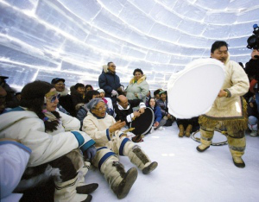
Inuit Drum Dancing
As Uriash Puqiqnak of Gjoa Haven, Nunavut says: “In our culture, happiness is important. Drum dancing is a way of celebrating, of being happy, of bringing good spirits to the people. If you are having a good time, good hunting will come through. When you are happy, you have to move – you can’t stay still” (Dewar 1994:27).
Luke Arna’naaq discussed different sizes of drums that he remembered in his childhood:
I recall seeing various sizes of drums. They were almost identical except the larger drums seemed oversized. The smaller drums . . . had fawn skin stretched over them. . . . Drums were purposely [designed] with the handles secured slightly at an angle and off centre . . . so the drum will be off balance. The top of the drum will want to fall, while the bottom “because it’s lighter“ will want to be on top. The handle was placed like this to eliminate stress in the dancer from trying to keep the drum balanced during the drum beating. Drums that are made like this are surprisingly easy to handle. . . .
http://native-drums.ca/en/drumming/an-inuit-drum/
https://bit.ly/2Q2kO8v

Slide 8
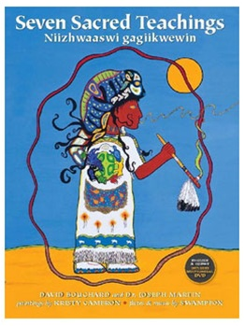
Seven Grandfather Teachings
Wisdom: Beaver-Blue-F
Love: Eagle-Violet-B
Respect: Buffalo-Black-E
Bravery: Bear-White-G
Honesty: Raven-Red-D
Humility: Wolf-Yellow-C
Truth: Turtle-Green-A
https://bit.ly/2mISr59

Slide 9
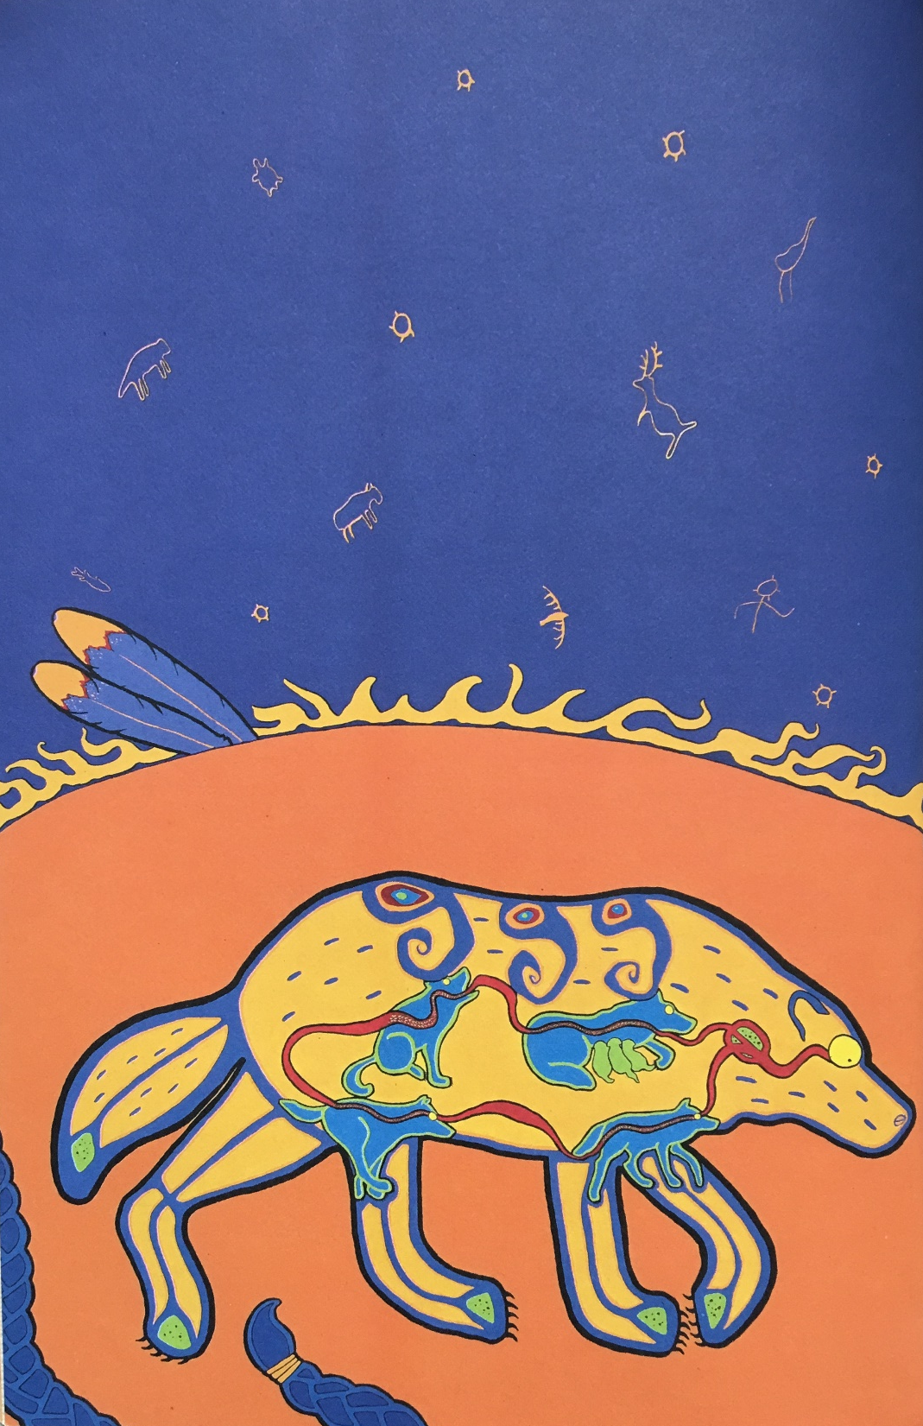
Humility-The Wolf
“Look to Wolf – Ma’iingan - for humility. Observe how Ma’iingan does not live for himself but for the pack. Watch him bow his head in the presence of others. He does this out of deference, not fright. Ma’iingan understands what a small part of the whole he plays. His ultimate punishment is to be cast away from his community.”
Learn this kind of humility. Learn to not be arrogant. Do not think too highly of yourself. Do not want for yourself. Become Ma’iingan. Become humble.

Slide 10
Honesty-Raven
Now is the time for you to be honest with yourself; see and accept yourself for who you are. Then and only then might you accept others for who they are.
Be honest with yourself as well as with others. When you speak, speak truthfully.
Kitchi-Sabe is the four-legged who walks on two legs. Sabe reminds us to be ourselves and not someone we are not. An honest person is said to walk tall like Kitchi-Sabe.
Raven understands honesty. Like Kitchi-Sabe, Raven accepts himself and knows how to use his gift. He does not seek the power, speed or beauty of others. He uses what he has been given to survive and thrive. So must you. To want more than you have been given is to suggest that the creator has not give you enough. You have enough.

Slide 11
Respect-Buffalo
Look to Buffalo – Bashkode-bizhiki – for one who models Respect. And honour him. That Bashkode-bizhiki offers himself to sustain you does not make his life any less than yours. It makes it more.
Not long ago countless Bashkode-bizhiki roamed the west. I said that he would disappear if he was not respected. Is respect, like Bashkode-bizhiki, disappearing from Turtle Island?
Do not waste. Use all things wisely. Never take more than you need and always give away that which you do not use. And treat others as you would have them treat you, respectfully. Learn respect and learn balance. What goes up will come down. What you do for others will be done for you. What you give away will always come back to you in the One Circle.

Slide 12
Courage-Bear
Look to Bear – Makwa – to model Courage.
You are older now. Your hair is white. You are in the winter of your life. You have learned much. You understand to always act on what is right for you and for your family. To do what is right is not easy. It takes courage. It takes courage to heal that which is not well within you before being reborn. Become healer. Become Makwa.
Just as courage sleeps in Makwa through long winter months, it is dormant within you. It need only be awakened.
Observe Makwa fight when her young are threatened. She will not stop until she overcomes any and all threats. In your life, you will need courage to transform fears that might prevent you from living a good life. Makwa shows you how to face fear and danger.

Slide 13
Wisdom-Beaver
To live your life based on your unique gift is to live wisely.
You are not the same as your neighbour. You were created special. You are one of a kind. So is your neighbour. So are the tree and the flower. You need only look to see that it is so. Do not ask questions. Watch and listen. Notice what is going on around you. Observe your life and the lives of others. By watching and listening you can learn everything you need to know. Knowledge can be learned. Wisdom must be lived. Live and learn.
Look into any clear lake. You do not see your reflection. You see that of those who came before you. Through All Your Relations and this Teaching of Wisdom, you will come to use your gift to direct your life’s journey. Do not live based on what you wish you were. Live on what you are. If you have been given the gift of song, then sing. If yours is the gift of dance, then dance.
Look to Beaver – Amik – for Wisdom. Amik has formidable teeth. Do you know what will become of Amik if he does not use his gift? His teeth will grow until they are no longer of any use to him. They will hinder him. Amik uses his gift wisely to thrive and so must you.

Slide 14
Truth-Turtle
Mother Earth was created on the back of Turtle – Miskwaadesii. Look to Miskwaadesii to understand truth.
There are thirteen Moons on her back; one for each moon cycle of one earth revolution around the sun. The Thirteen Moons and the Thirteen Grandmothers are signs that Mother Earth cares for you.
Look to Miskwaadesii for one whose existence is strong and stable. Slow-moving Miskwaadesii understands, as you should, that the journey of life is as important as the destination.

Slide 15
Love-Eagle
Look within yourself for Love. Love yourself, and then love others.
You cannot love another until you first learn to love yourself.
You must understand and live the other six Teachings before you can love.
Love is worth working for. Love is worth waiting for. Love is the key to life.
There is no short cut to achieving the state of love and you cannot know love unless you are courageous. You cannot know love unless you are honest. Love is based on the wisdom to understand one’s self and the humility to accept weaknesses as well as being proud of one’s strengths. Love has as its very core the other Teachings. This is why I give it to you last.
The loving heart centre of each Uhkwehu:weh or true-hearted person lies within each of us.
Love is deep violet and is modeled by Eagle – Migizi. Migizi flies high above the earth and sees all that is true. Migizi is honest. She is courageous. She exemplifies all my Teachings. She is closer to me than any other. Look to her as one who represents and models Love. And honour her, always.

Slide 16
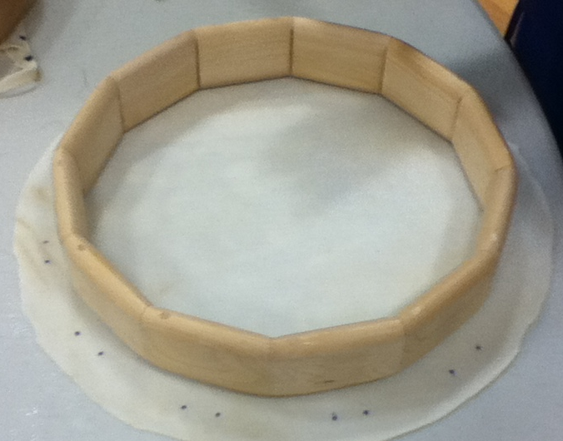
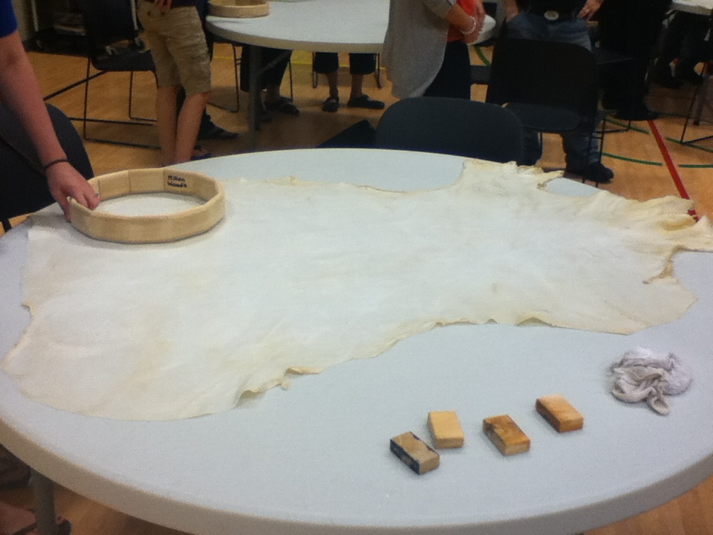
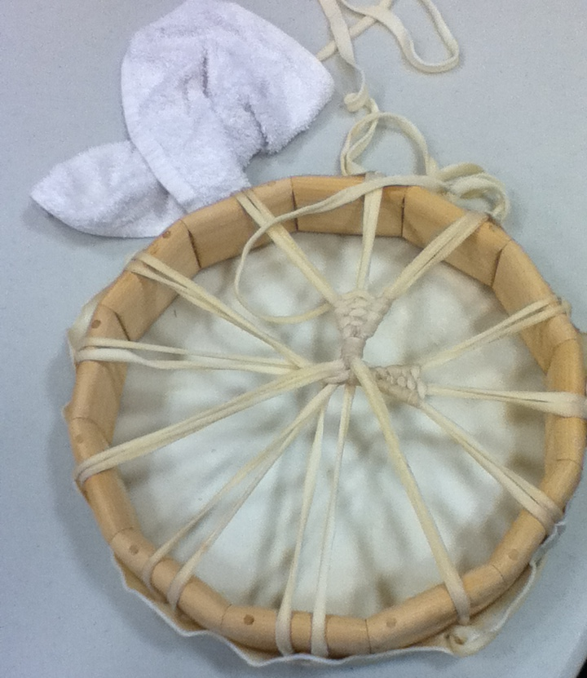
Making Deer Skin Drums with Sky Buffalo
Notes:
-Parent Reaching out grant
-Contact Nicole Robinson about funding related to Indigenous projects
-Ontario Arts Council grants

Slide 17
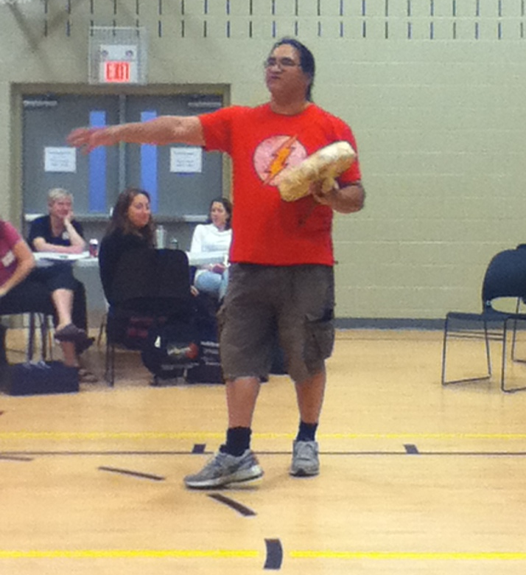
Assemblies/Workshops
Prologue Artists: Tribal Vision (Six Nations)
John Samosi from Sky Buffalo

Slide 18
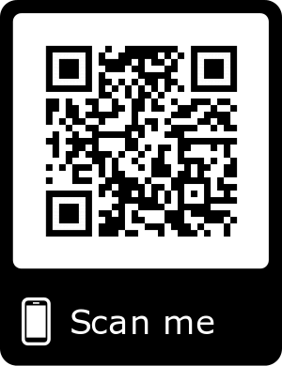
Reflect upon the last three classes.
What are two things you will take away from these past few classes?
What questions do you still have?
Can you see yourself incorporating an Indigenous perspective into your future classroom/teaching setting?
https://bit.ly/2Ie7pHR
Notes:
You all have a reason for being here, you all are here for a reason.
If at the end, you still have questions or gaps in your knowledge, please let me know!
We’re all coming from different places of knowledge, and that’s ok!

Slide 19
For more information:
Who are the Inuits?
Learn more: Traditional Inuit Music
TSO: Inuit Games
Learn more about the 7 Grandfather teachings here
Indigenous Studies Portal: University of Saskatchewan
Handbook for Educators of Aboriginal Students
First Nations, Métis, and Inuit Connections: Scope and Sequence (K-8)
First Nations, Métis, and Inuit Connections: Scope and Sequence (9-12)
Email me! If you have a question, or are looking for a resource, just ask!
Niki Kazemzadeh kaze6850@mylaurier.ca

